Slide 1
Architect
Tyler Warfle

Slide 2

Why?
I’ve never actually wanted to be an architect but I have to get this project done. Maybe I will be an architect now anyways, who knows?

Slide 3

Plans
If I were to go into architecture I would apply for the Penn State Department of Architecture. I picked that because it was the fist college that came up when you search architecture.

Slide 4
Architect- a person qualified to design buildings and to superintend their erection.

Slide 5
Salary
The lowest kind of Architect is called architect 1 and they make an average of $41,000 a year. They are the kind of architect that are right out of college with a bachelors. They are usually not in charge and report to a superior. Does make any plans just carries out tasks

Slide 6
The highest paid kind of architect is called a Customer Relationship Management architect. Requires at least a bachelors degree and 7 years of experience. Has a team of people that report to him/her and leads these people. They make an average of $125,000 a year.

Slide 7
The program
It is a 5 year bachelor program that does drawing, model making, and hands on construction which prepare the students for newer forms of architecture like computer design and digital architecture and conventional forms of drawing and knowledge.

Slide 8
http://www.arch.psu.edu/programs/courses.shtml <-- A link to the course descriptions over the 5 years

Slide 9
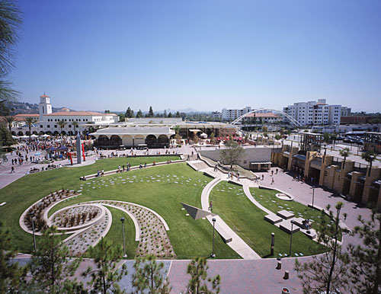
This is what it looks like…

Slide 10
Citations
http://www.arch.psu.edu/
http://www1.salary.com/Architect-Salary.html

